Slide 1
Aspen Crossing Homeowners’ Association 2020 Annual Meeting
October 21st, 2020

Slide 2
Zoom Meeting
Let’s do a quick “Technology Check” to ensure all Aspen Crossing Residents are able to attend if so desired.

Slide 3
Agenda
Board Introduction
HOA-Administrators Overview
2020 Activities & Updates
Covenants / Bylaws Review
Financial Review
Construction Update
2020-2021 Projected Activities
Questions
End of Meeting

Slide 4
2020 HOA Board Introduction
Board Member | Role / Responsibility
Rich Sullivan | Chief Financial Officer / Financials
Noah Bleicher | Director of Operations / Communications
Brian Beam | Director of Development / Infrastructure
Noah, Brian, Rich | Architectural Committee
*Sam Sullivan | HOA Administrators / Covenants

Slide 5
Homeowner Correspondence
When the Board needs to communicate to the Homeowners at large, it will be via one of two ways:
Sent Electronically via the HOA Website or via Email
HOA Website
www.AspenCrossingHOA.com
Email
In order to receive prompt notification of HOA news and information, we encourage you to confirm your email address on the website

Slide 6
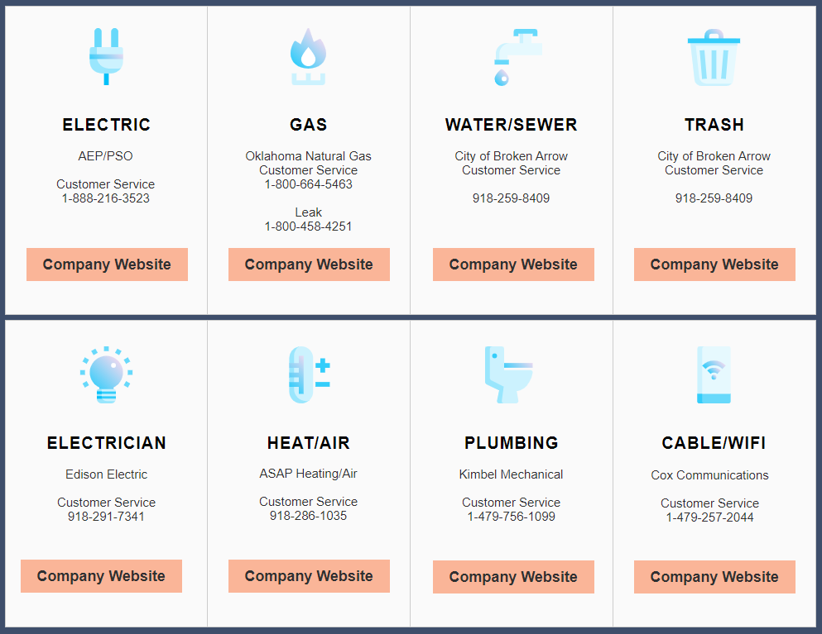
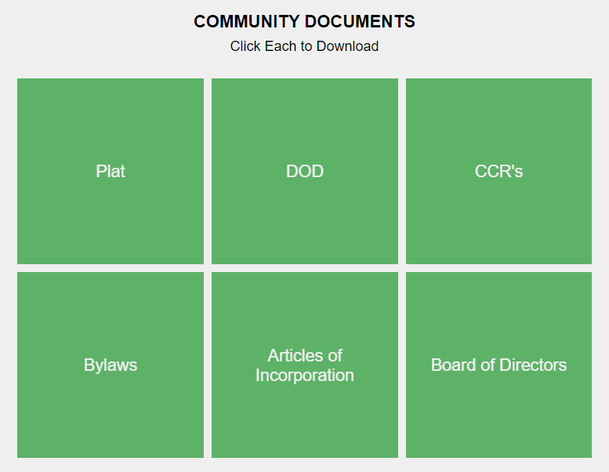
HOA Website
www.AspenCrossingHOA.com
This will be the primary form of communication between Board & Homeowners
Has Community information, Utilities Info, HOA documents (DOD, CCR’s, Financials)

Slide 7
HOA Administrators’ Roles & Responsibilities
HOA Management Company Provides:
Financial and Accounting Services
Administrative Services
Property and Community Management
Covenant Supervision and Violation Management
Communication Platform for Homeowners
Renewed Services (8/2020), 1-year Contract
HOA Administrators is the primary manager of the Aspen Crossing HOA on behalf of the Board

Slide 8
Administration of Covenants
HOA Covenants are in place for the purpose of enhancing and protecting the value, desirability and attractiveness of the Community as a whole and enhancing the quality of life within the Community
If you are want to learn more about Community Covenants, please visit the HOA website and download a copy of the CCR’s
Proactive Homeowner Communication with HOA-Administrators is paramount for effective covenant management

Slide 9
Within Scope of Board
Common Covenant Violations & Topics include:
Trailers / Boats / RVs parked in driveway for extended period
These items can be parked on property for a 24-hour period except as may be designated by the Association
Yard Maintenance
Stationary Vehicles
Parking
Fences / Sheds / Pools Applications & Approvals

Slide 10
Outside Scope of Board
Common Issues NOT covered by HOA Board Covenants:
Speeding vehicles
Construction traffic/parking
Neighborhood roads and road maintenance
Police or Legal matters

Slide 11
Covenant Violations
HOA Administrators performs MONTHLY neighborhood inspections looking for Covenant violations.
They are also who you should contact should you wish to report a potential Covenant Violation (Sam@HOA-Administrators.com)
A list of the current Covenants (CCR’s) can be found on the Aspen Crossing HOA Website (www.AspenCrossingHOA.com)

Slide 12
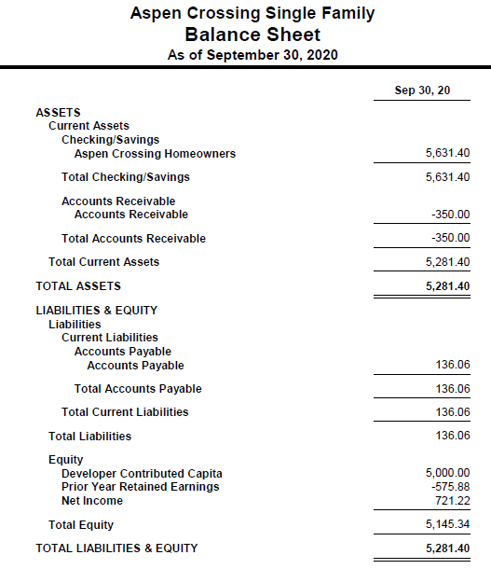
Financial Review – HOA Balance Sheet
Dedicated HOA bank Account (August, 2019)
Developer contributed $5k to HOA (seed $)
Total PH 1 # of homes
36 closed
9 under contract
3 remaining
Total = 49
Phase 2 = 42 Lots (2021)

Slide 13
HOA Financials – Income Stmt / 2021 Budget
9/30/20: 32 homeowners
2020 Dues were billed on 1/31/20
Budget assumes all homeowner pay dues
2020 Financials on HOA Website

Slide 14
Construction Update
Re-laying the walking trail in concrete
Adding gate to Aspen Crossing Patio Homes
Streets, Water, Sewer all Public Infrastructure City of Broken Arrow.
Broken Arrow Website: https://seeclickfix.com/

Slide 15
2020-2021 Areas of Focus
Continued Construction of homes in Aspen Crossing Phase I
Beginning of Phase II of Aspen Crossing
Upgraded Website & Administration (www.AspenCrossingHOA.com)

Slide 16
Questions from Homeowners

Slide 17
Meeting Adjourned But don’t forget to register on the HOA Community Website! www.AspenCrossingHOA.com

