Slide 1
Aspen Crossing Homeowners’ Association 2022 Annual Meeting
November 2nd, 2022

Slide 2
Agenda
Board Introduction
HOA, Administrators, & Website Overview
Covenants / Bylaws Overview
2021-2022 Activities & Updates
Financial Review
Q3 & Q4 Projected Activities
Questions
End of Meeting

Slide 3
HOA Board Introduction
Board Member | Role / Responsibility
Rich Sullivan | Chief Financial Officer / Financials
Noah Bleicher | Director of Operations / Communications
Brian Beam | Director of Development / Infrastructure
Sam Sullivan | HOA Administrators / Covenants
Noah, Brian, Rich | Architectural Committee

Slide 4
Point and Purpose of an HOA
The Home Owners’ Association (HOA) is a not-for-profit entity charged with financial stewardship and covenant administration on behalf of the Homeowners, among other responsibilities.
All HOA’s have Community documents, known as CCR’s (Covenants, Conditions, & Restrictions). These are the “official rules” of the neighborhood that are filed with the County and are publicly available (and on the website).
One of the main responsibilities of an HOA is to protect the integrity and consistency of the Community by maintaining shared Common Areas and holding Homeowners accountable to the rules of the CCR’s.

Slide 5
3rd Party HOA Manager Roles & Responsibilities
The HOA Board hires a 3rd party company (HOA Administrators) to serve as a point of contact for Homeowners and an execution arm for the Board. HOA Administrators is responsible for:
Financial and Accounting Services
Administrative Services
Property and Community Management
Covenant Supervision and Violation Management
Point of Contact for Homeowners
Latest Contract 1/1/2022 for 1-year (revolving)
HOA Administrators is the primary manager of the Aspen Crossing HOA on behalf of the Board

Slide 6
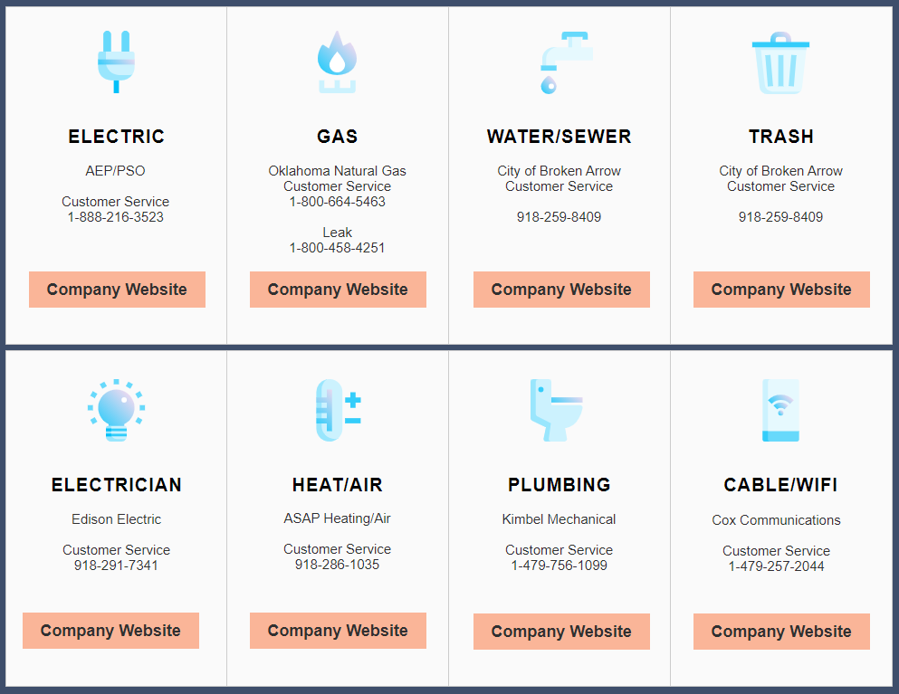
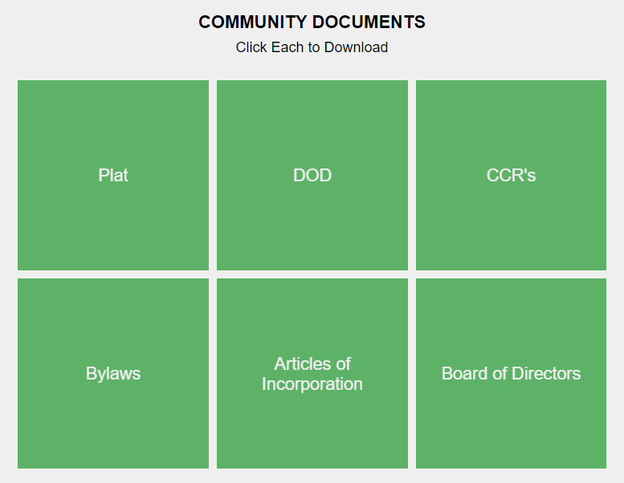
HOA Website
www.AspenCrossingHOA.com
This will be the primary forum of communication between Board & Homeowners
Has Community information, Utilities Info, HOA documents (DOD, CCR’s, Financials)

Slide 7
Homeowner Correspondence
When the Board needs to communicate to the Homeowners at large, it will be via one of three ways:
Sent Electronically via the HOA Website (ex: Community Announcements)
Sent Electronically via Email (Admin@AspenCrossingHOA.com)
Sent “Snail Mail” via USPS (ex: Annual Dues, Notices, CCR Violations)
The Aspen Crossing HOA Website is: www.AspenCrossingHOA.com
The website is a resource for Community information, Utilities contacts, and HOA documents (DOD, CCR’s, Financials)
It also has a Community Message Board for neighbors to ask questions, post notices, or make announcements

Slide 8
Covenants, Conditions, & Restrictions (CCR’s)

Slide 9
What are HOA Covenants?
HOA Covenants are in place for the purpose of enhancing and protecting the value, desirability, and attractiveness of the Community as a whole and enhancing the quality of life within the Community
They specify Community rules and dictate requirements for Common Area Maintenance (CAM), among other things
The Covenants, Conditions, & Restrictions (CCRs) are filed with Tulsa County and are available on the HOA Website
Ultimately, they are in place to support the individual Homeowners’ quiet enjoyment of their home and to preserve the financial investment for each member of the Community

Slide 10
Covenant Administration
HOA Administrators performs MONTHLY neighborhood inspections looking for covenant violations
If you suspect a potential covenant violation, please contact Sam Sullivan: sam@hoa-administrators.com
If you are unsure about what is allowed per the CCRs, please read the Community documents first before reaching out to Sam Sullivan

Slide 11
What is the HOA Board entrusted to do?
Maintain the common areas and work with vendors
Hold all Homeowners to the same set of rules (CCR’s)
Be fiduciaries of the HOA’s finances and the integrity of the Community
Review/Approve Architectural Committee requests
Communicate with Homeowners and the municipality

Slide 12
What is NOT within the scope of the HOA Board?
Common Issues NOT covered by Aspen Crossing Patio Homes CCR’s:
Speeding vehicles
Construction traffic/parking
Neighborhood roads and road maintenance
Police or Legal matters

Slide 13
Financials

Slide 14
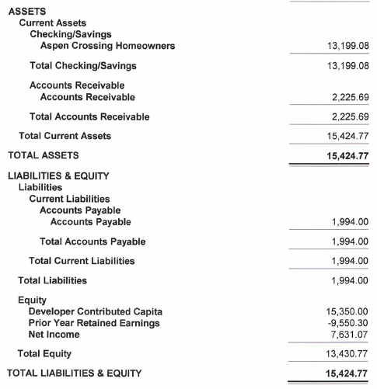
September, 2022 Balance Sheet
Dedicated HOA bank Account (2018)
Developer contributed $15k to HOA (seed $)
Cash: $~13k in operating acct
Total lots at completion = 91

Slide 15
HOA Financials – September 2022 Profit Statement
2022 Annual Dues $450
88 homes (September 30)
Under contract: +3
Budget assumes all homeowners pay dues
4 outstanding (9/30)
CHRG still pays portion of dues
~$3,650 monthly burn rate
2022 Financials are on AC SF HOA Website
Dues will increase to $500 on 1/1/23

Slide 16
Community Activity

Slide 17
Construction Update
This is a Community finishing out the active Construction phase. As such, some construction debris will be present but it should be minimal moving forward. We appreciate your patience.
If you have any Construction-related Community issues to report (excessive debris, issues with your home, etc) please report via Capital Homes Warranty website: https://www.capitalhomes.com/warranty

Slide 18
2021 – 2022 Activity
2021 and 2022 saw continued growth and near close-out of the Community
23 homes closed year to date as of Sept, 2022.
CHRG is almost sold through the Community and will be transitioning the HOA management to the Homeowners in mid-2023.
See, Click, Fix – VERY helpful program for residents to report issues to City of BA

Slide 19
2023 HOA Transition
The HOA Board transition will likely take place mid 2023 and we will post ample notice and information on the HOA website (www.aspencrossinghoa.com)
We will distribute details well in advance of next year’s Annual HOA Meeting and will plan to hold the election at next year’s meeting with target Turnover Date of 7/1/2023.
We strongly encourage Homeowner participation in their Community’s future!
HOA Administrators will be glad to continue Financial Services for 2023 to aid in transition

Slide 20
Questions from Homeowners

Slide 21
Meeting Adjourned And don’t forget to visit the Aspen Crossing Single Family HOA website! www.AspenCrossingHOA.com

